Slide 1
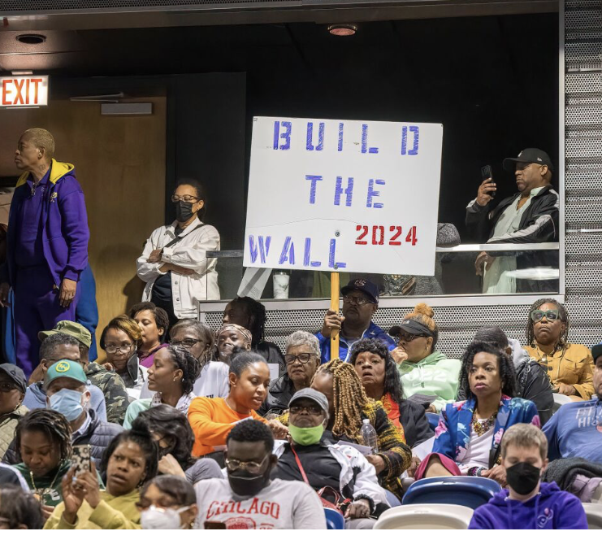
The Social Costs, Who Are The Real Victims

Slide 2
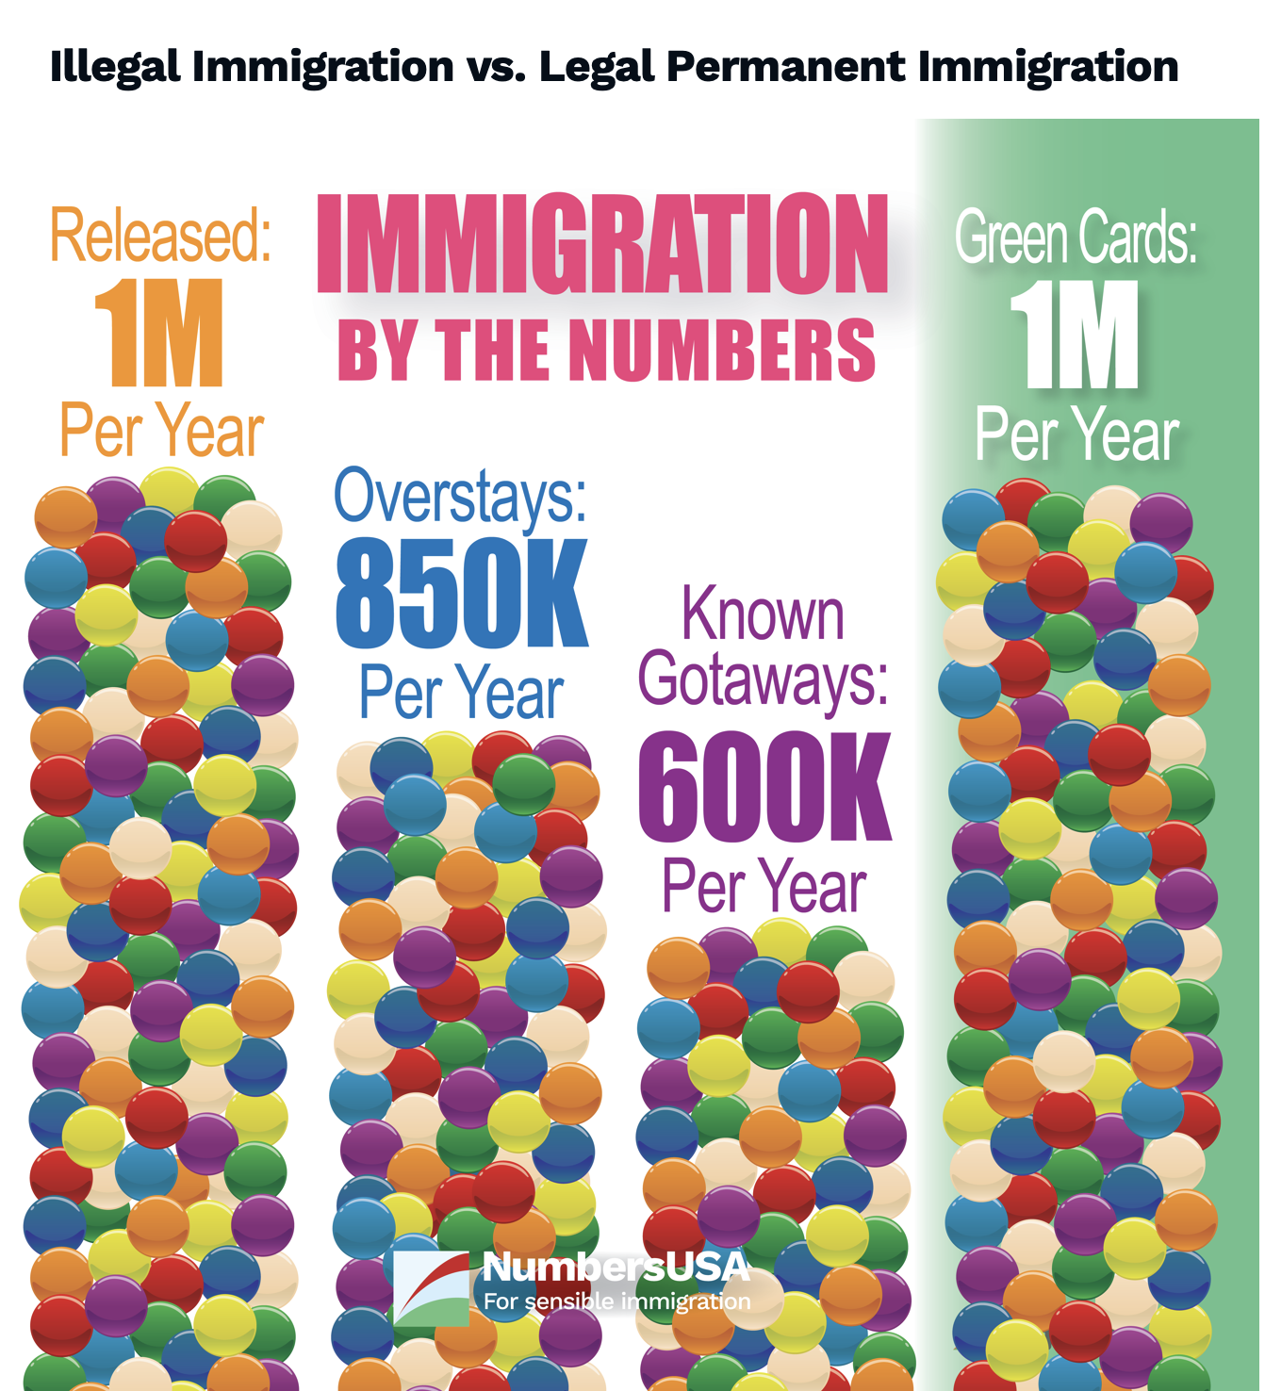
Immigration by the numbers
1 million released by border patrol.
850,000 visitors overstayed their visas and remain illegally in 2022.
600,000 estimated to have entered the US without apprehension.
1 million people obtain Green Cards every year.

Slide 3
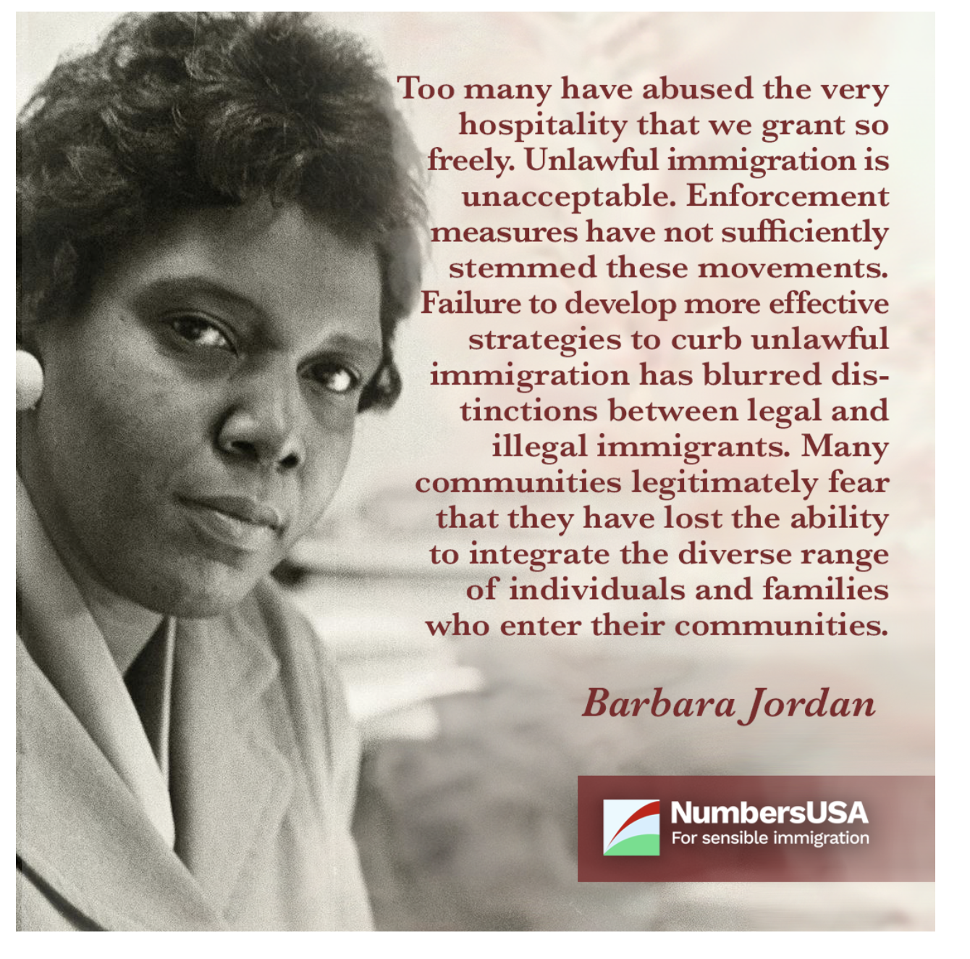

Slide 4

What are people saying about Mass Immigration?
Decreases employment opportunities
Decreases wages
Creates competition for social services
Increases rent and housing prices

Slide 5

Why are they saying it now?

Slide 6
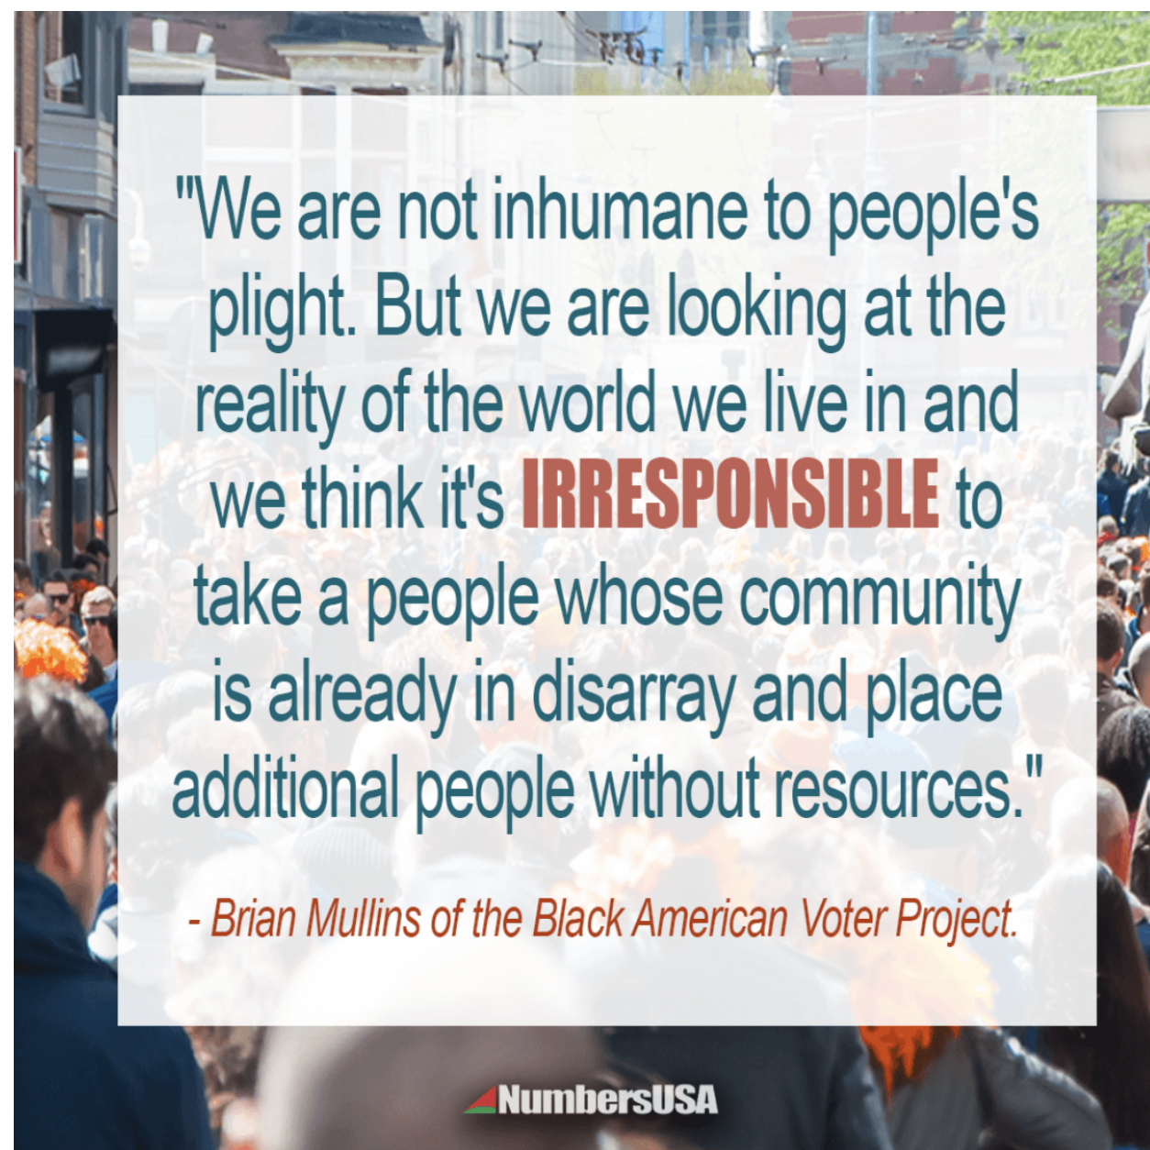
Facts about wages
Immigration redistributes roughly $500 billion from workers to owners of capital.
  Every year, immigration reduces the wages of competing American workers by an estimated $493.9 billion; or
  A 5.2 percent decrease in income.
  The most vulnerable Americans are the most harmed.
  Businesses gain an estimated $548.1 billion every year from the lower labor costs.

Slide 7
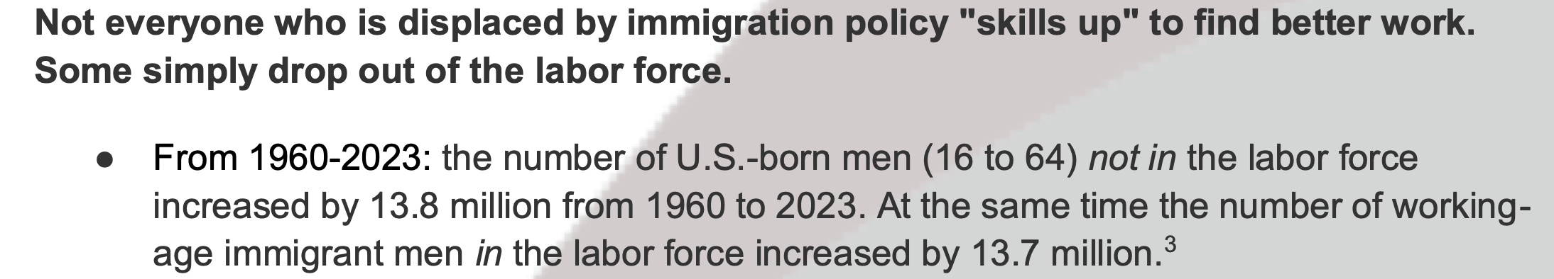
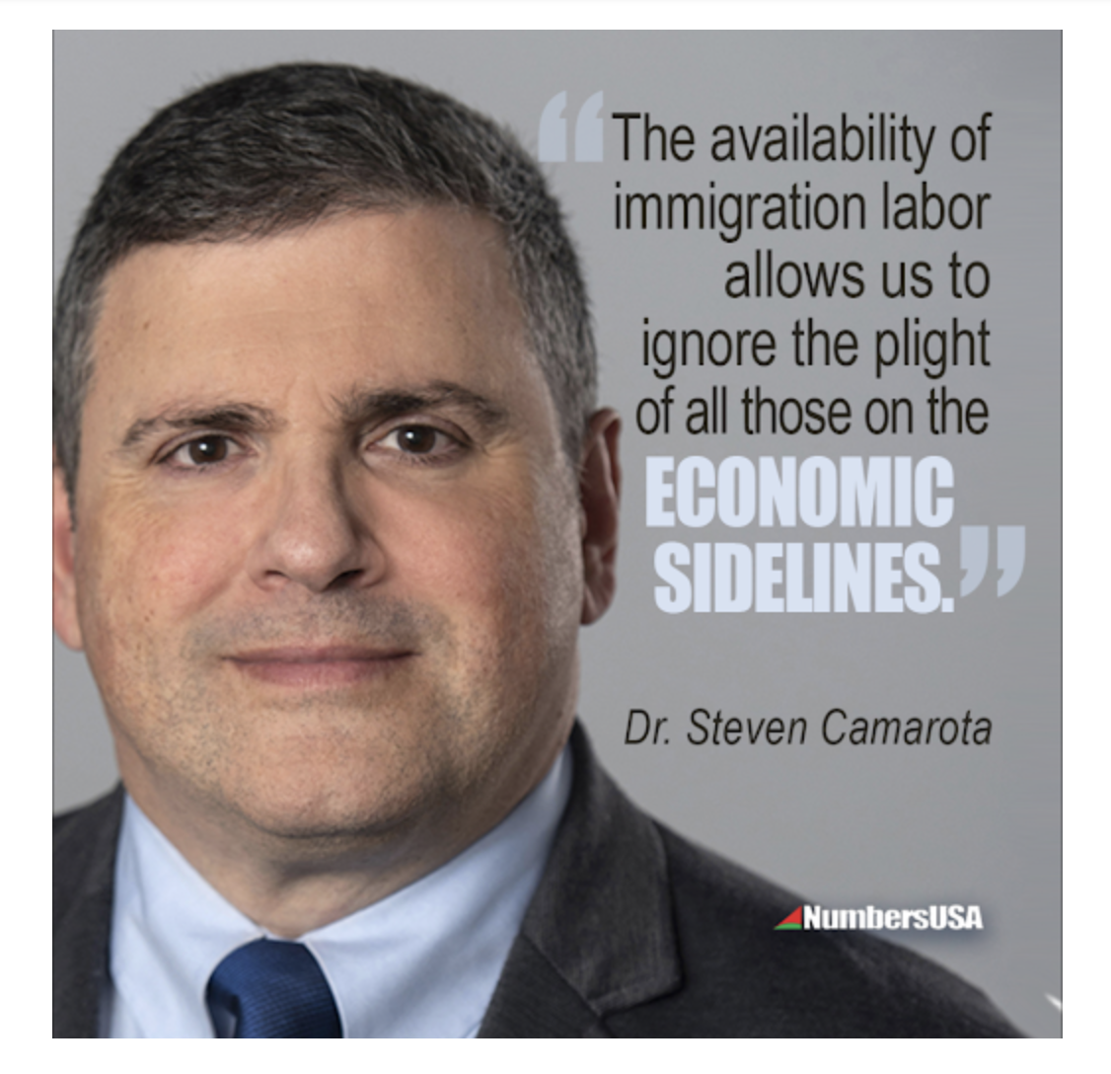
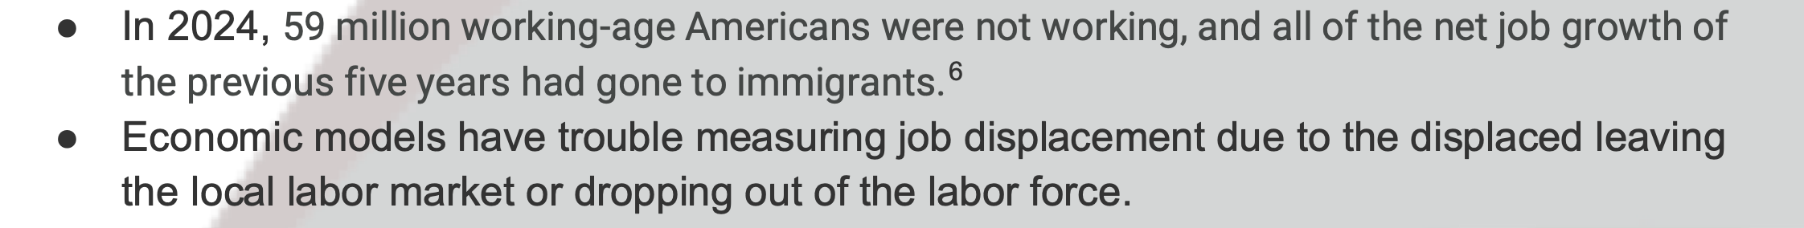
Facts about employment

Slide 8
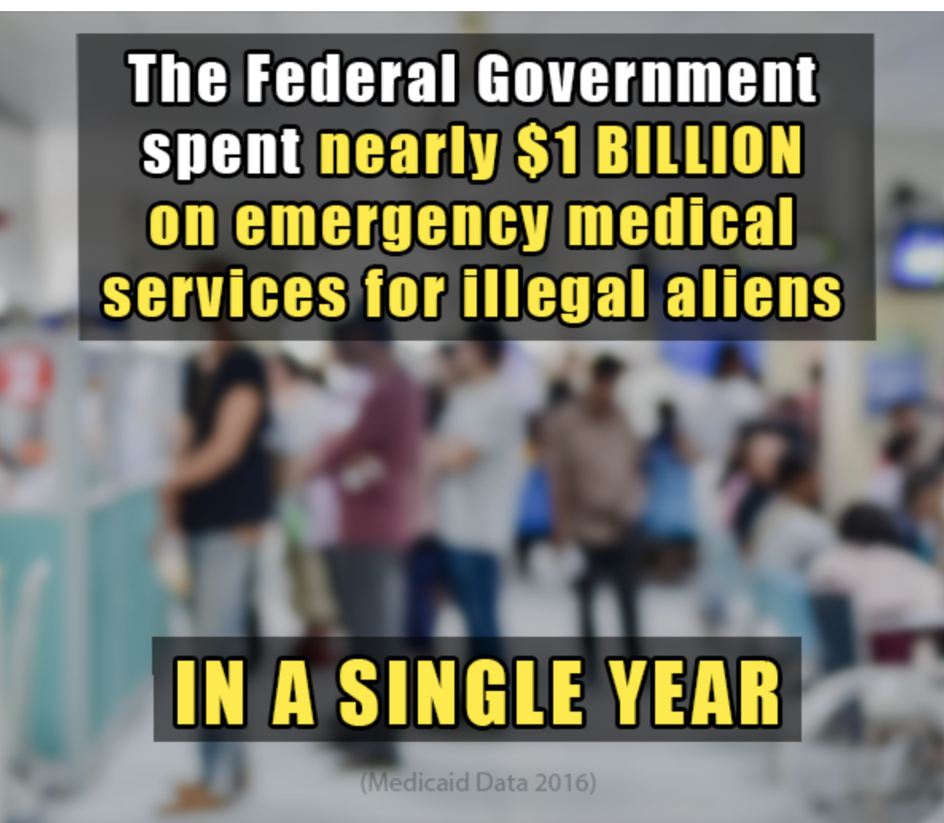
Facts about Social Services
“The unfortunate reality is that the City has extended itself further than its resources will allow, placing in jeopardy the City’s obligations to manage its finances in order to maintain critical infrastructure and services and provide for the well-being of all of its citizens,” wrote Jonathan Pines.

Slide 9

Facts about the housing market
America has a population growth policy. Immigration laws are responsible for between 88% and 95% of U.S. population growth
Population growth results in higher housing costs.
A new study estimates that it will take 83 percent of Denver millennial renters twenty years or more to save enough for a 20 percent down payment on a median-priced condo at current market value.
Since 1960, renters’ incomes have increased by only 5% while rents have risen 61%.

Slide 10
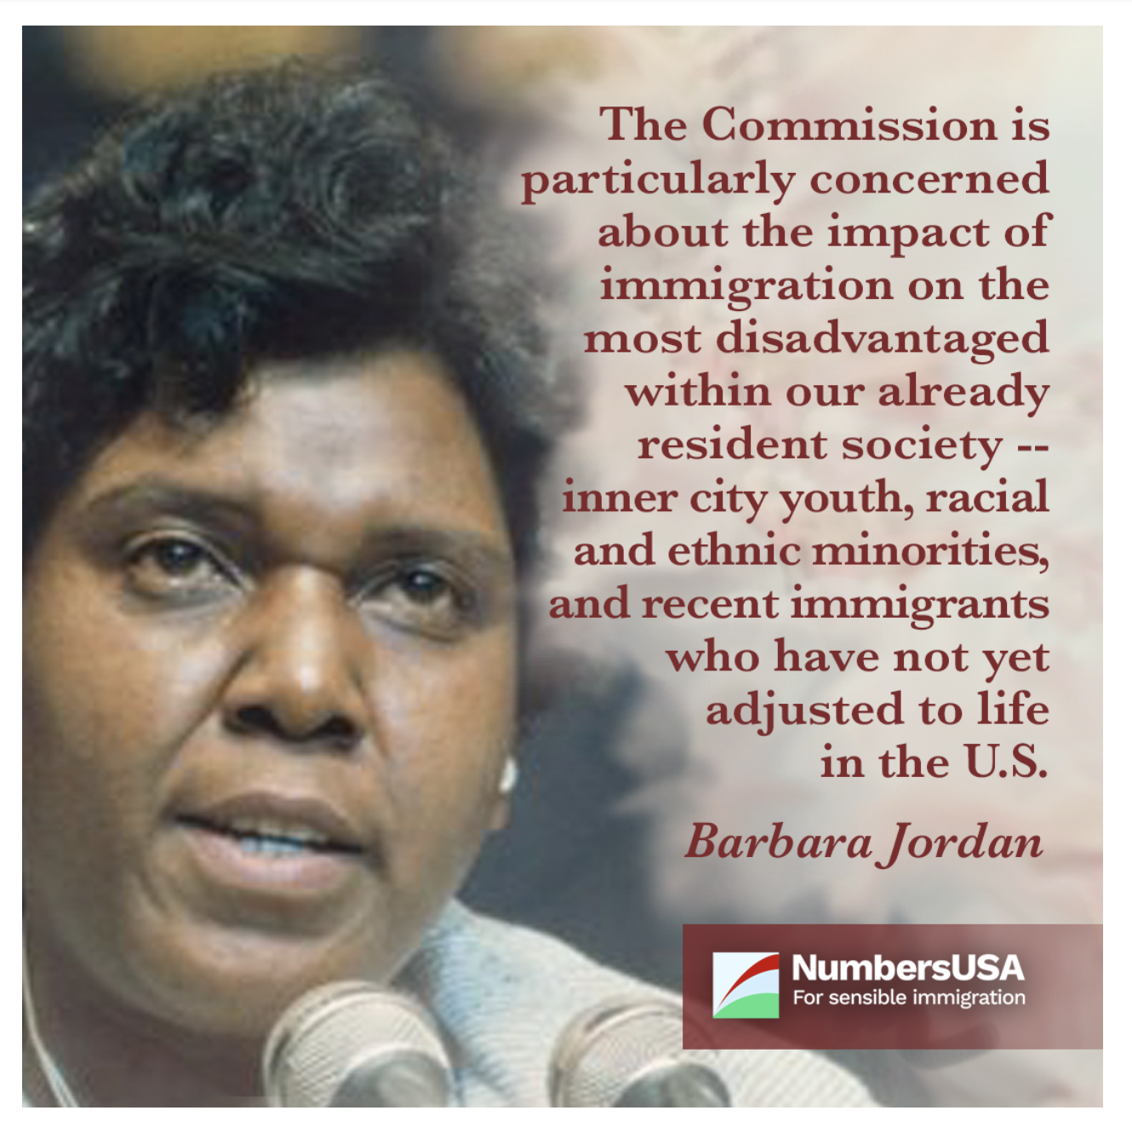
The real victims
Teenagers
High School Dropouts
Formerly Incarcerated
Americans with Disabilities
Black Americans
Recent Immigrants
Unauthorized workers

Slide 11
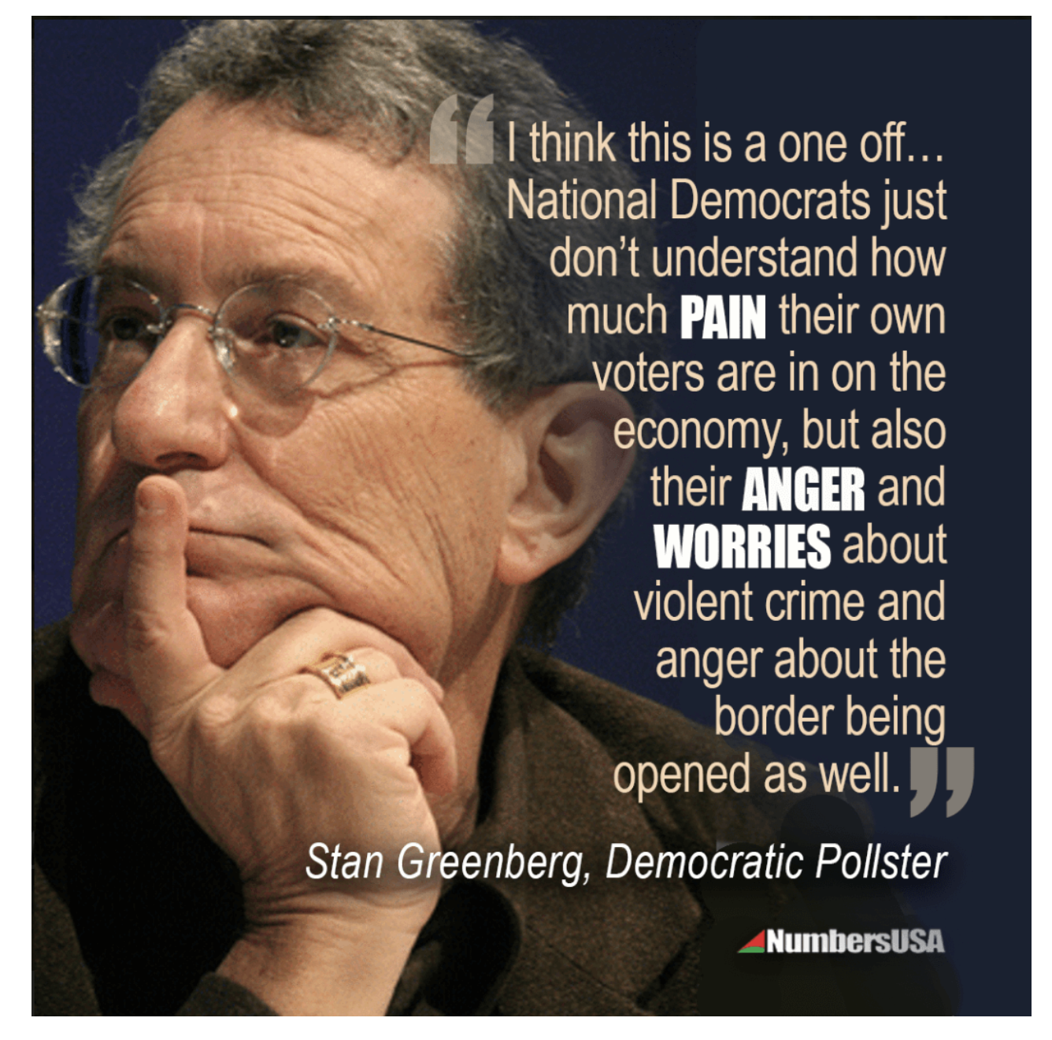
What is being done?
Citizens are pushing back
    Protest from grassroot organizations
    They are threatening to vote republican
    NumbersUSA utilizing education and activism as a sword
    Educating the people about immigration via townhalls, social media, and our website
    Pressuring elected officials with pushback from our 900,000 members across America
    Forming new alliances and partnerships to branch into new communities and territories.

